Slide 1
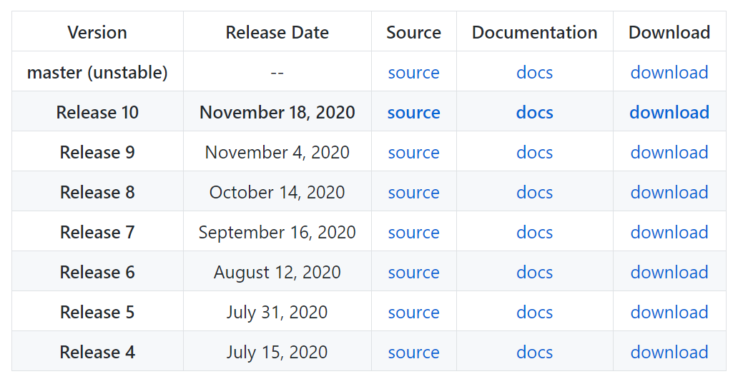
1. Download ML Agent Release 10 or later from GitHub
https://github.com/Unity-Technologies/ml-agents

Slide 2
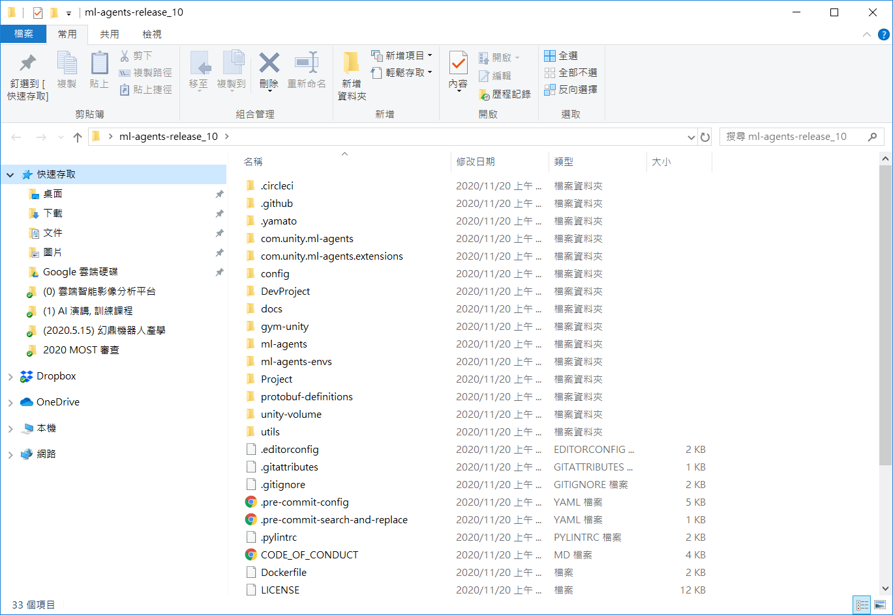
2. Unzip ml-agents-release_10 to your PC

Slide 3
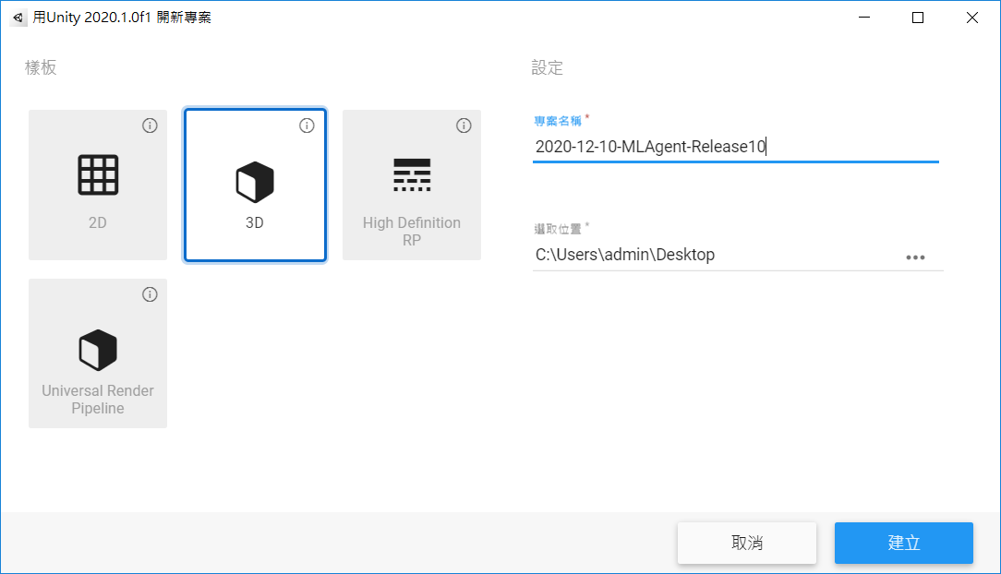
3. Create a new Unity project

Slide 4
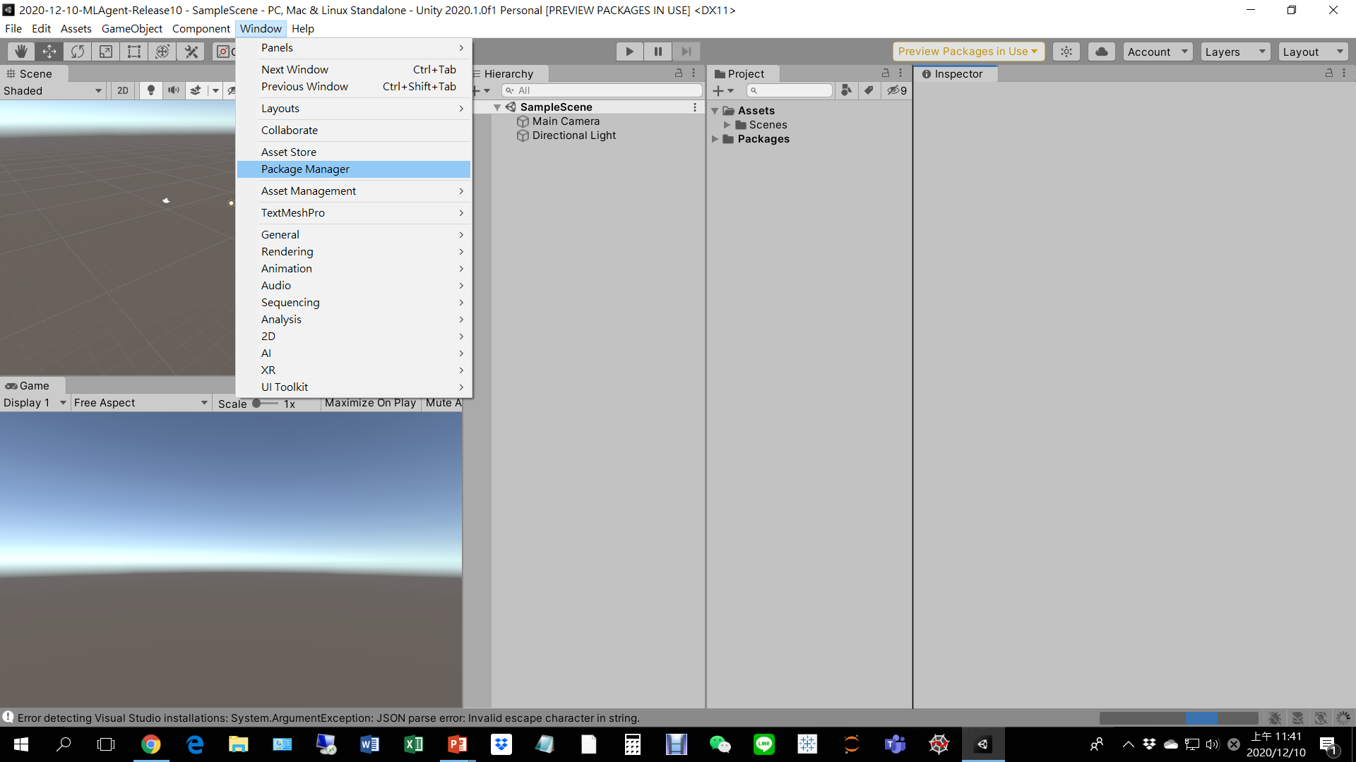
4. Use package manger to import ML Agent 10 to your Unity project

Slide 5
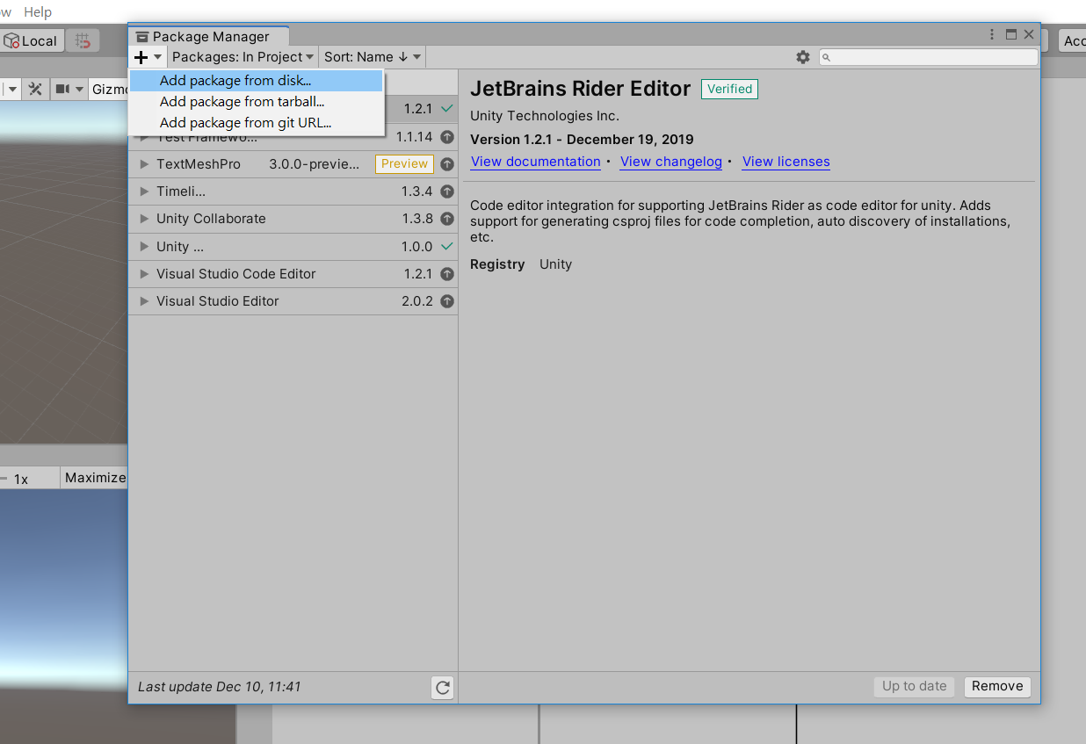
4. Use package manger to import ML Agent 10 to your Unity project

Slide 6
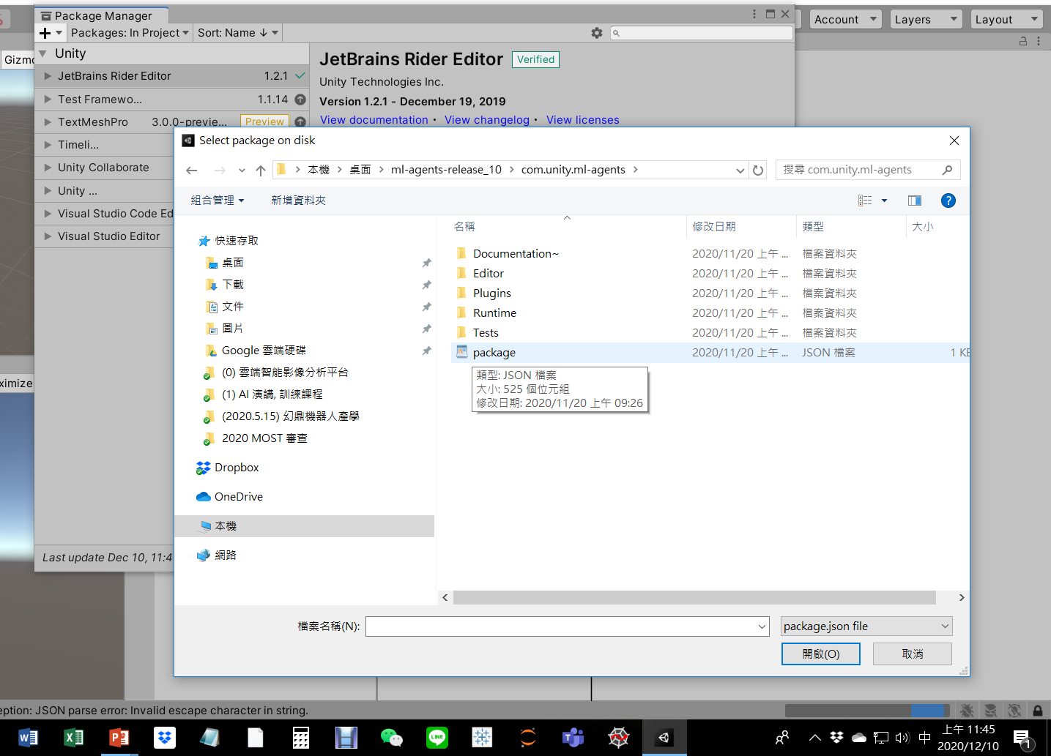
4. Use package manger to import ML Agent 10 to your Unity project
Select package.json in “C:\...\ml-agents-release_10\com.unity.ml-agents”

Slide 7
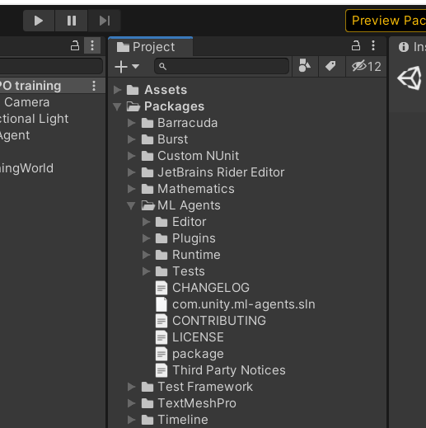
4. Use package manger to import ML Agent 10 to your Unity project

Slide 8
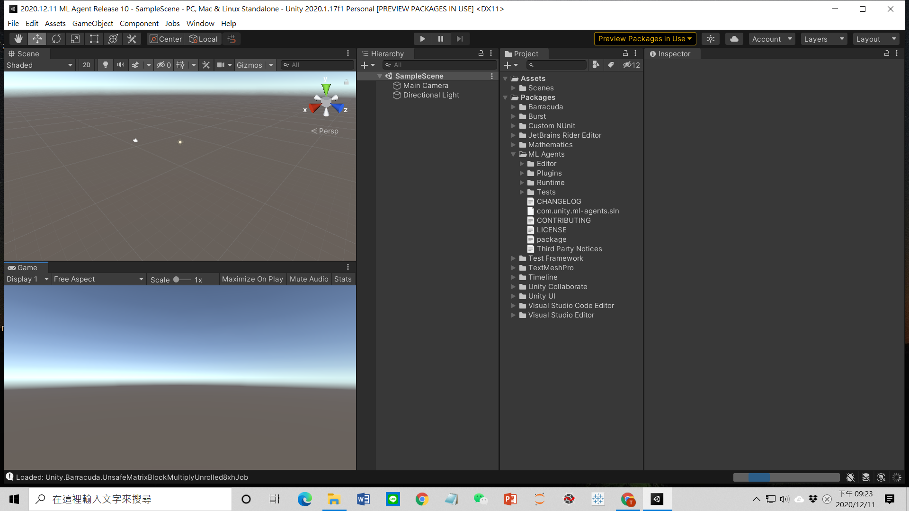
4. Use package manger to import ML Agent 10 to your Unity project
Still running, but OK to close Unity

Slide 9
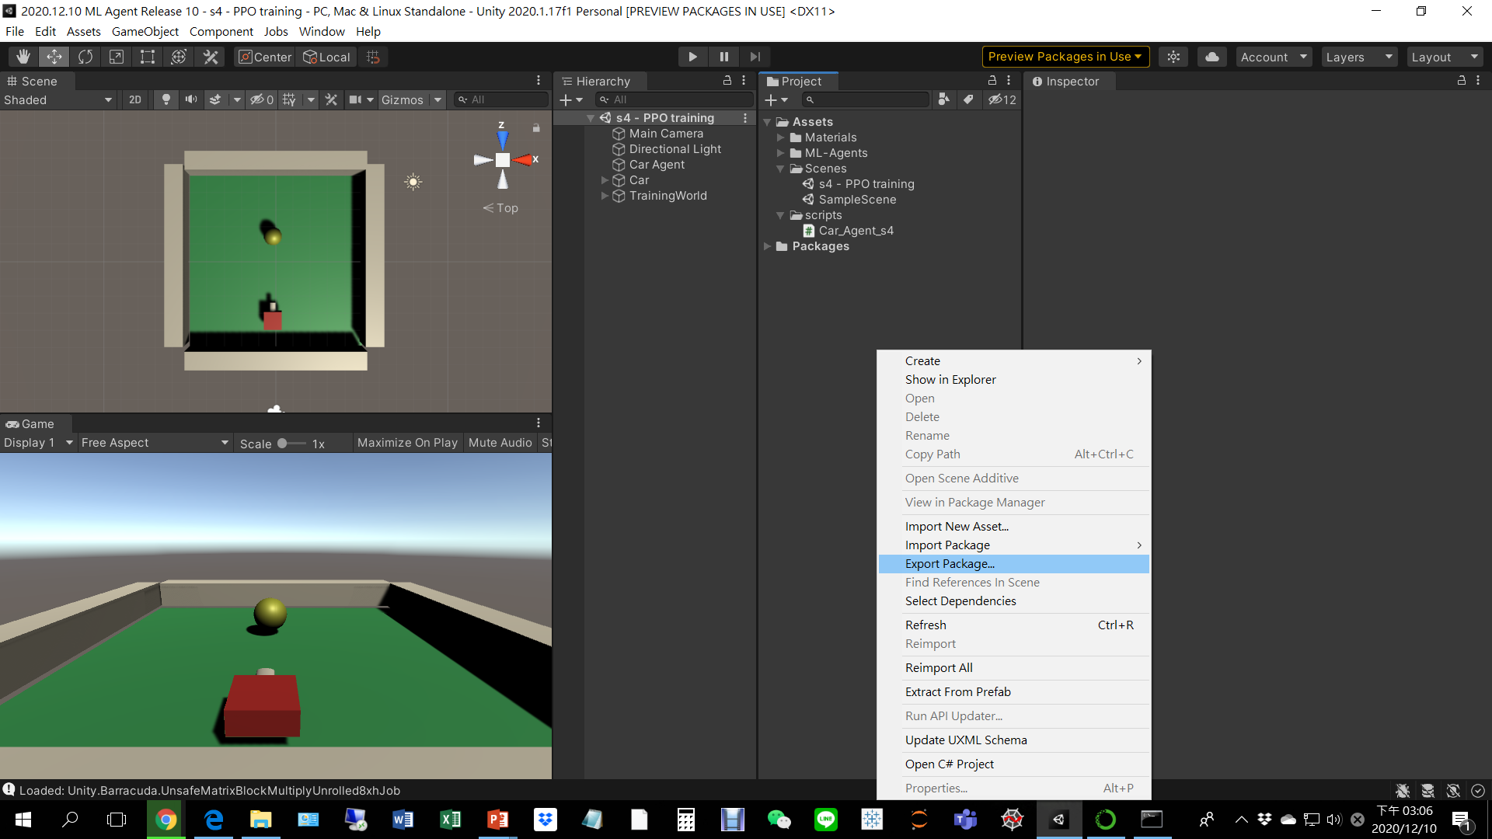
5. Use package to move your old Unity project scene to your new Unity project
Open your old Unity project, right click in the project window and select export package

Slide 10
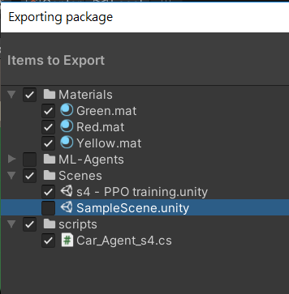
5. Use package to move your old Unity project scene to your new Unity project
Export materials, scenes, and cs

Slide 11
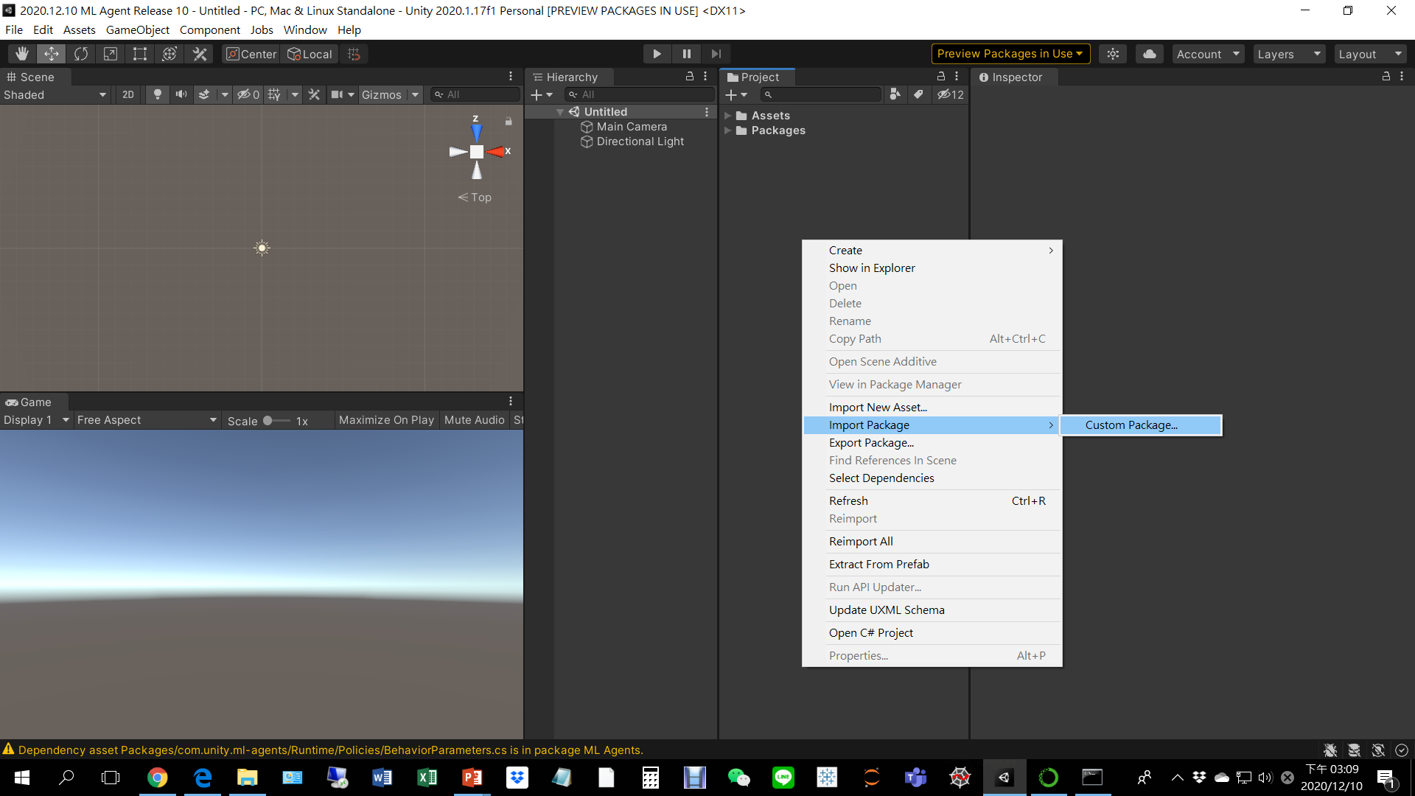
5. Use package to move your old Unity project scene to your new Unity project
Open your new Unity project, right click in the project window and select import package

Slide 12
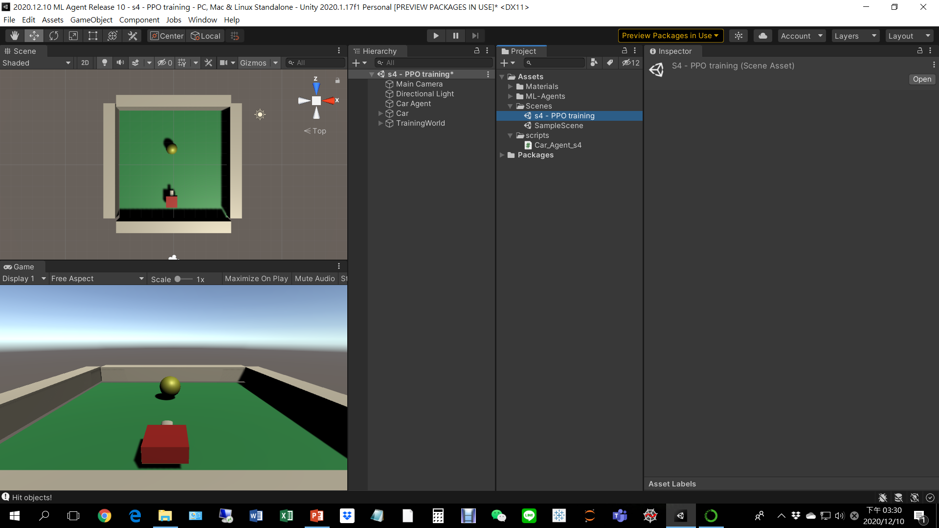
5. Use package to move your old Unity project scene to your new Unity project
Double click your scene

Slide 13
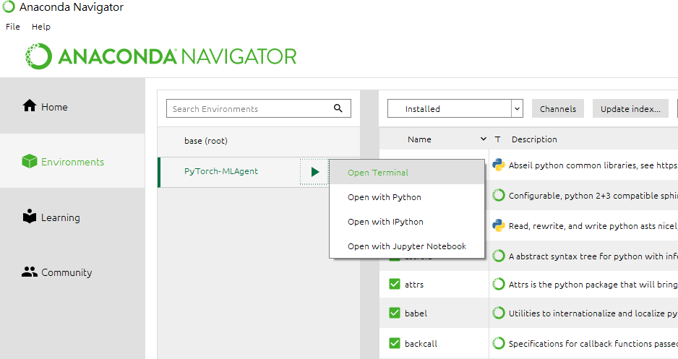
6. Install ML Agent to Anaconda

Slide 14
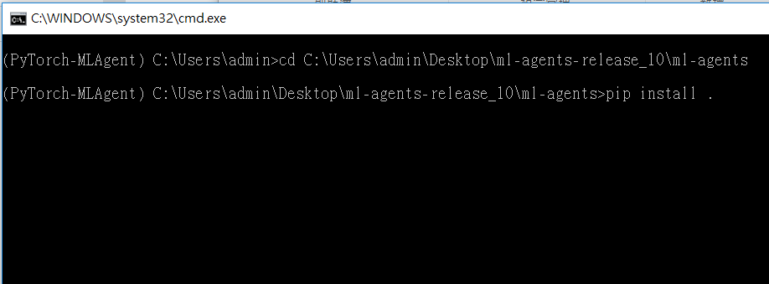
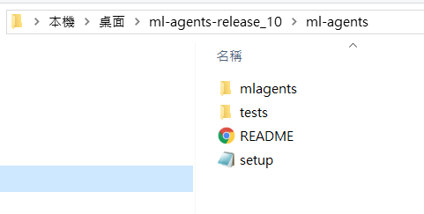
6. Install ML Agent to Anaconda
cd to the directory where the setup.py is located
pip install .

Slide 15
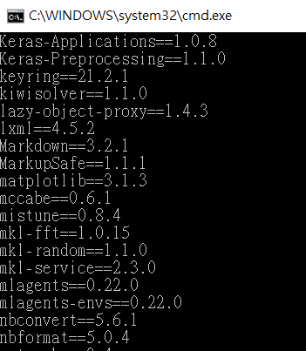
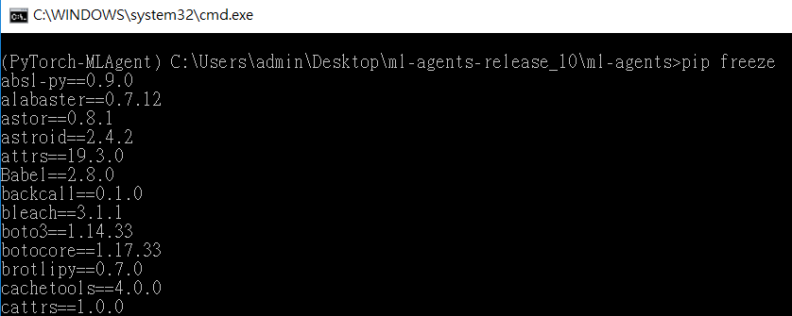
6. Install ML Agent to Anaconda
Type “pip freeze”to confirm

Slide 16
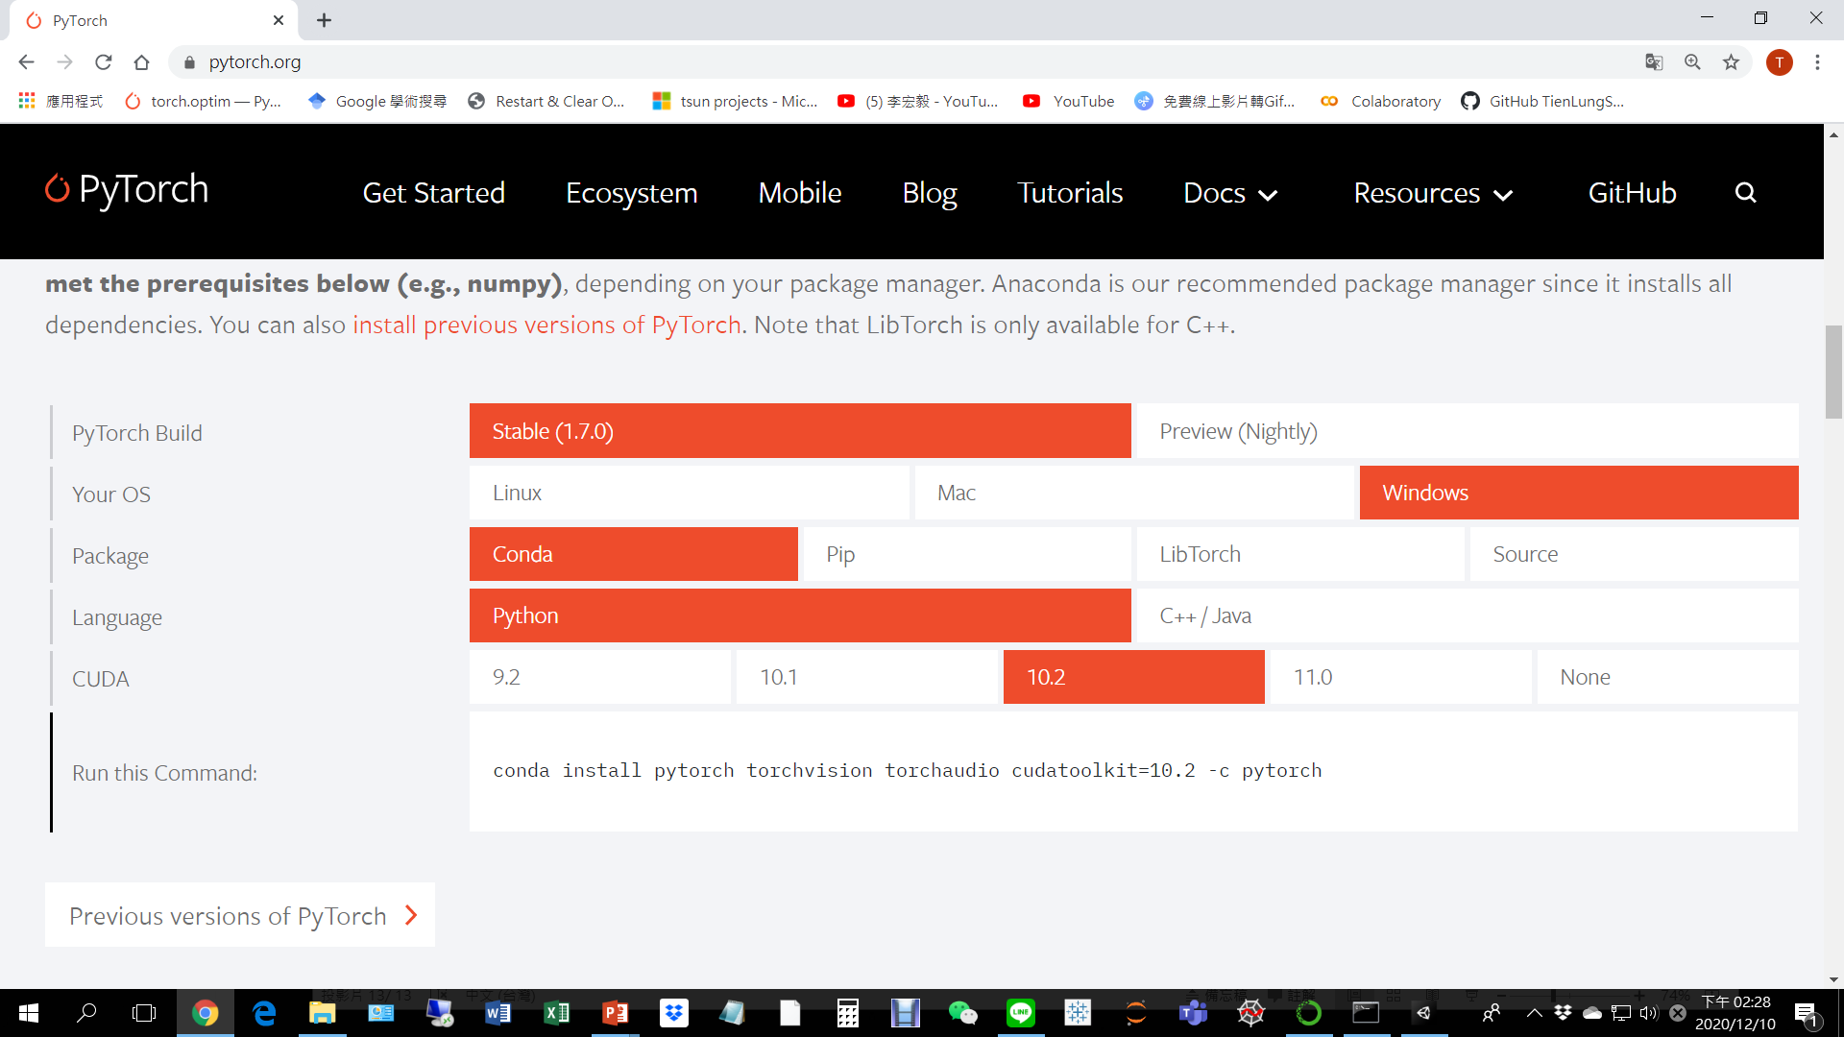
7. Update PyTorch to 1.6.0 or later
https://pytorch.org/

Slide 17
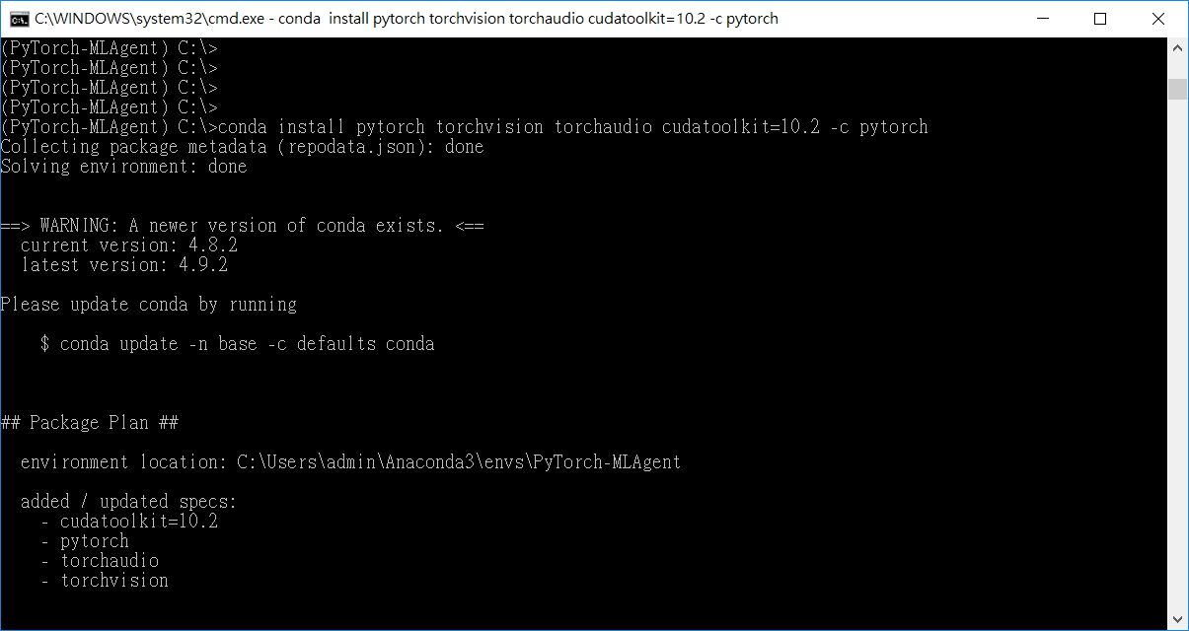
7. Update PyTorch to 1.6.0 or later

Slide 18
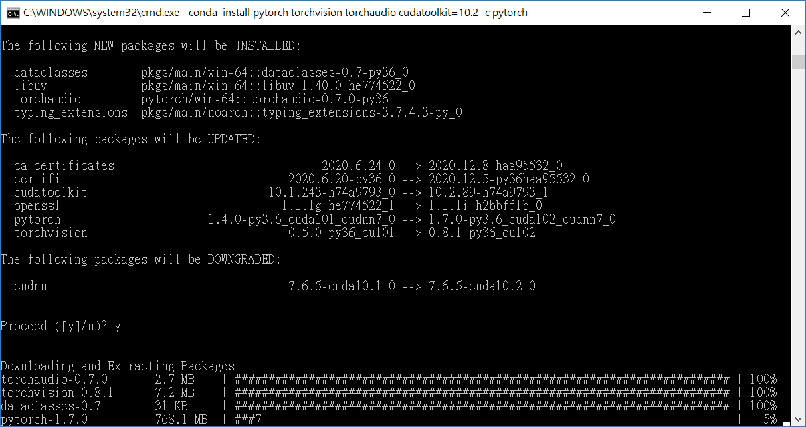
7. Update PyTorch to 1.6.0 or later

Slide 19
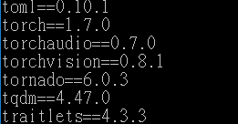
7. Update PyTorch to 1.6.0 or later

Slide 20
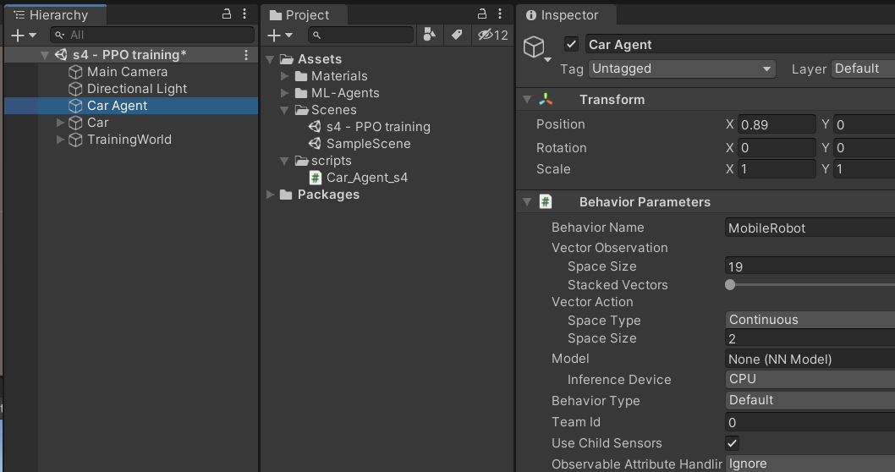
8. Change your behavior name

Slide 21
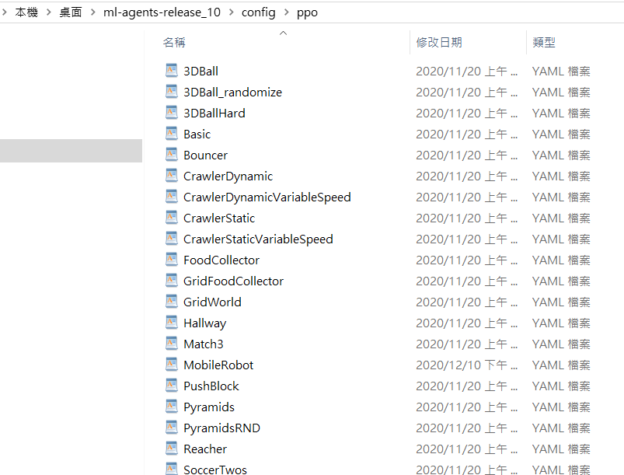
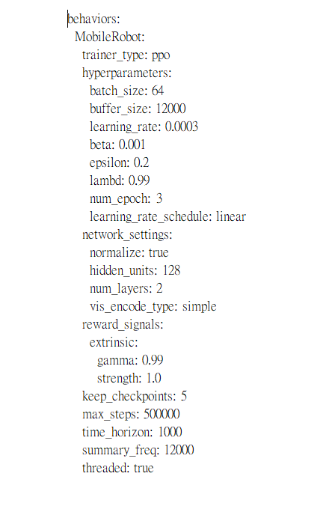
9. Create a configure file of the same name
You can copy 3DBall.yaml and rename the file name

Slide 22
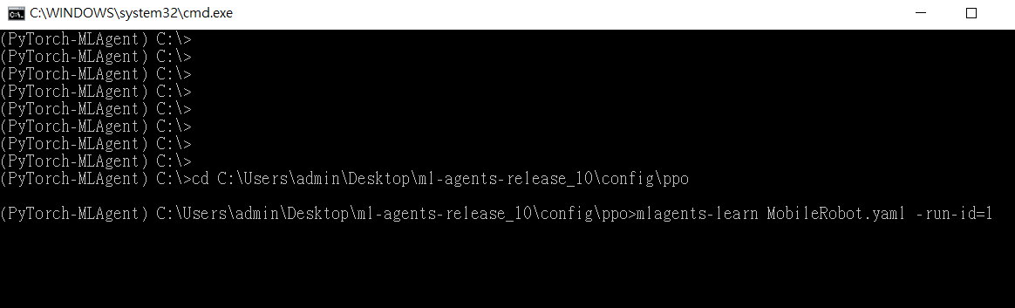
10. Run PPO based on your configure file
mlagents-learn MobilRobot.yaml --run-id=1

Slide 23
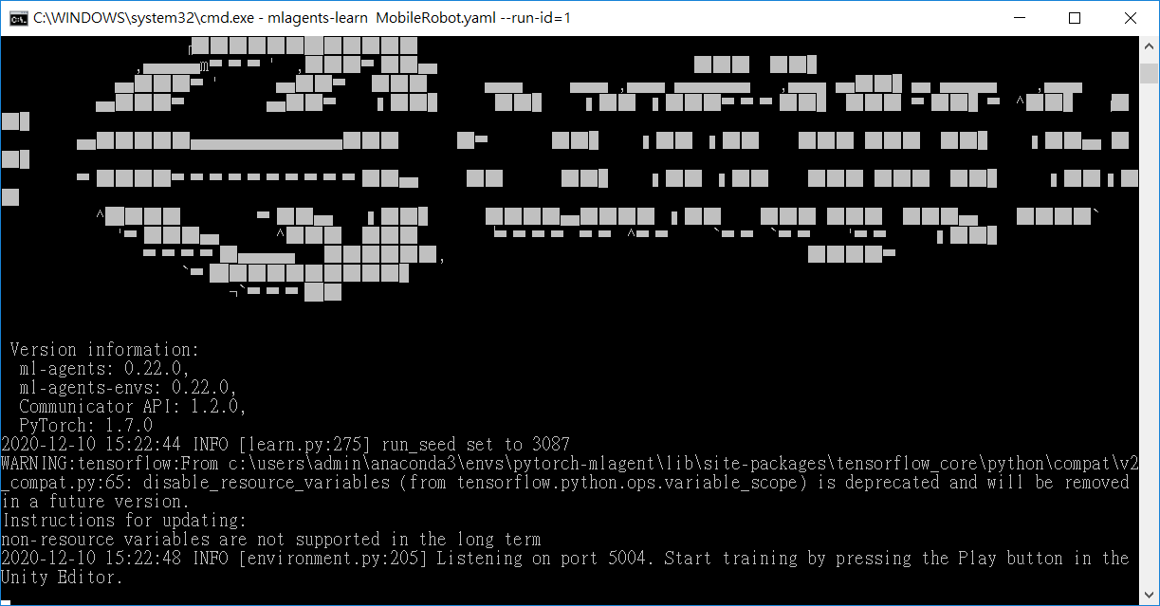
10. Run PPO based on your configure file

Slide 24
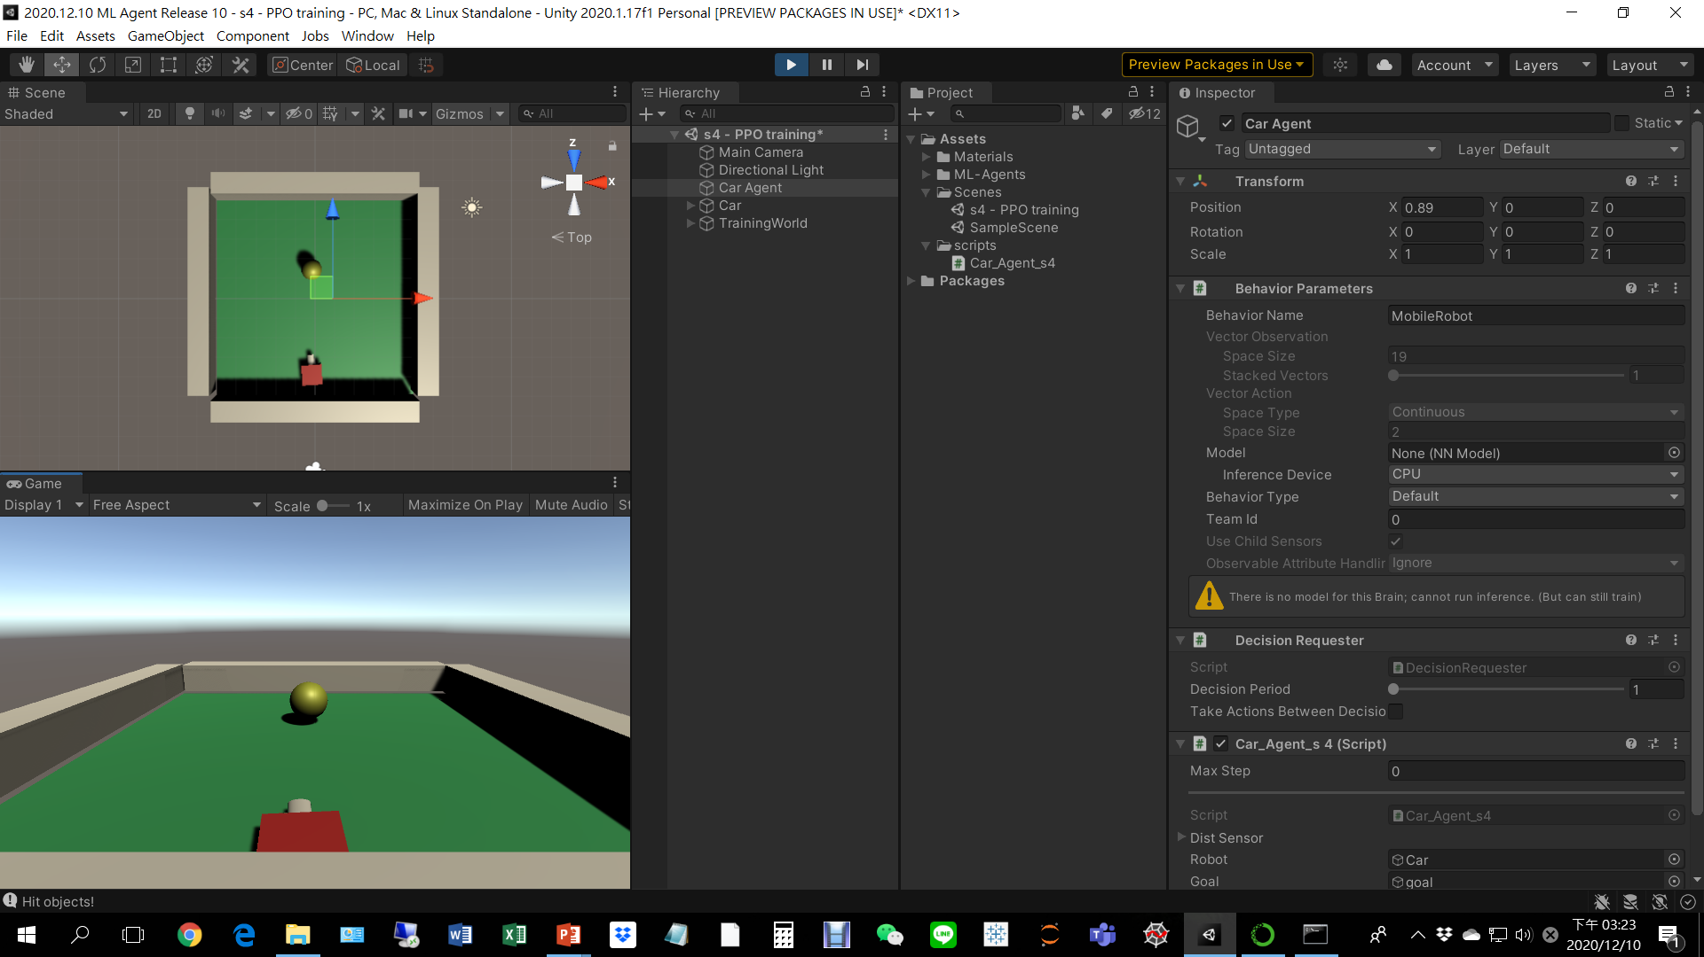
10. Run PPO based on your configure file

Slide 25
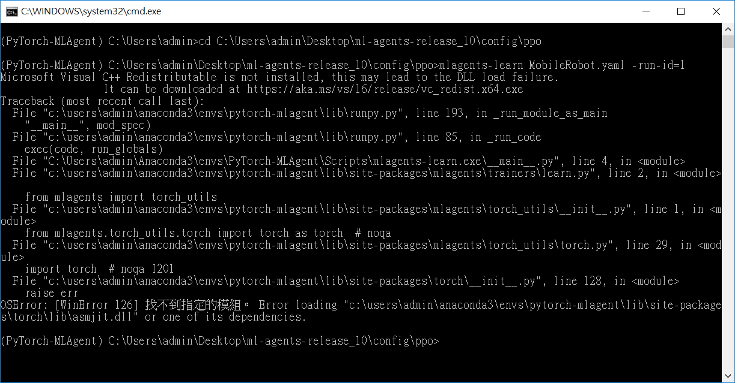
You might need to download MS VC redistributable
https://aka.ms/vs/16/release/vc_redist.x64.exe

Slide 26
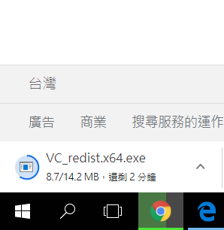
You might need to download MS VC redistributable
https://aka.ms/vs/16/release/vc_redist.x64.exe

Slide 27
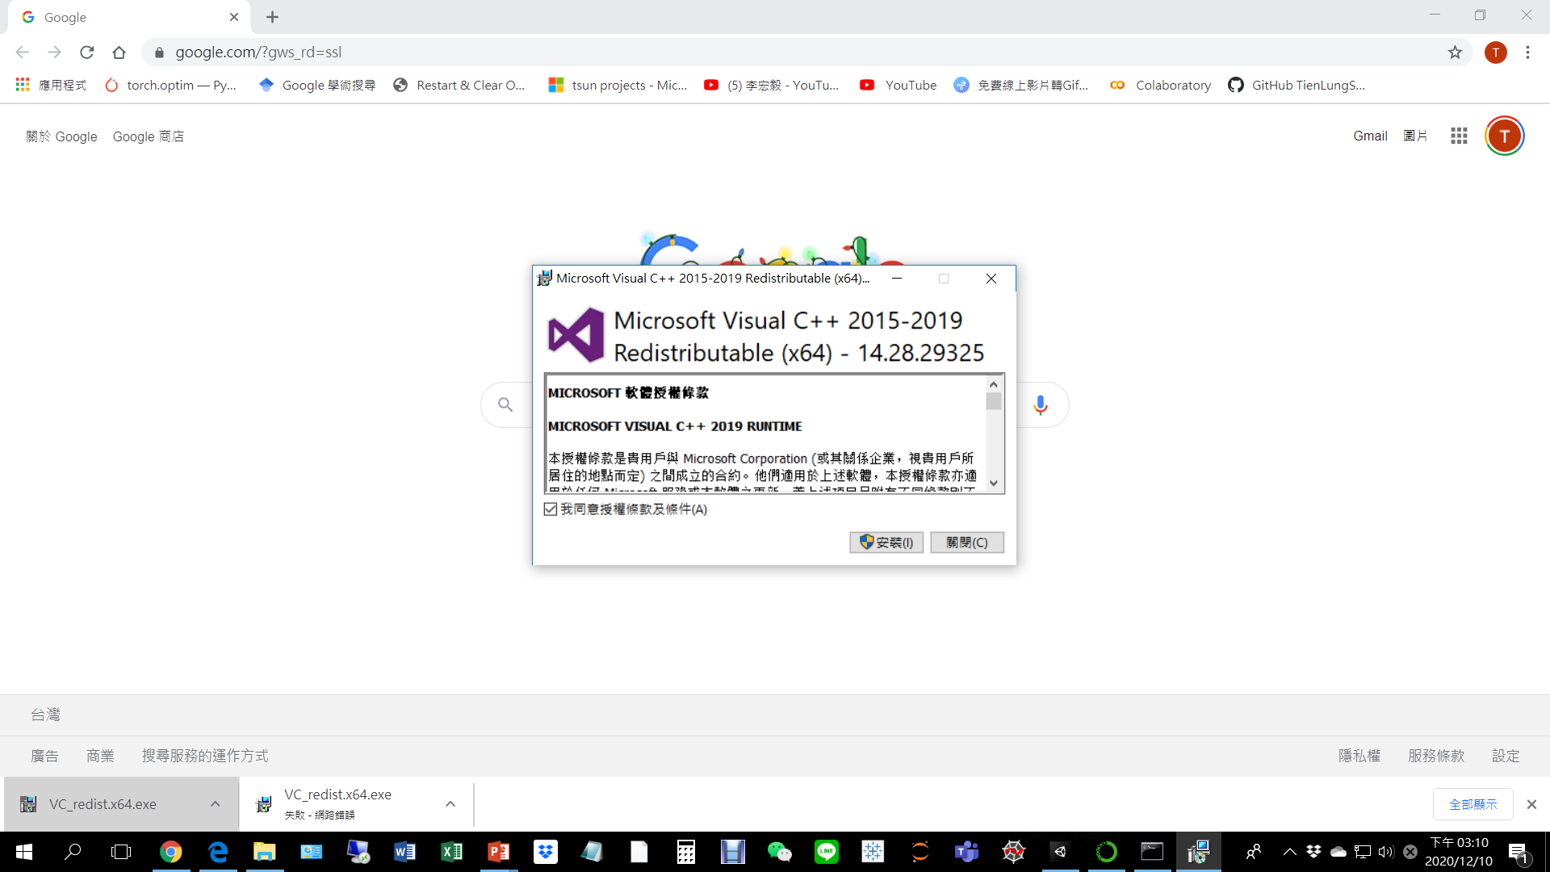
You might need to download MS VC redistributable

Slide 28
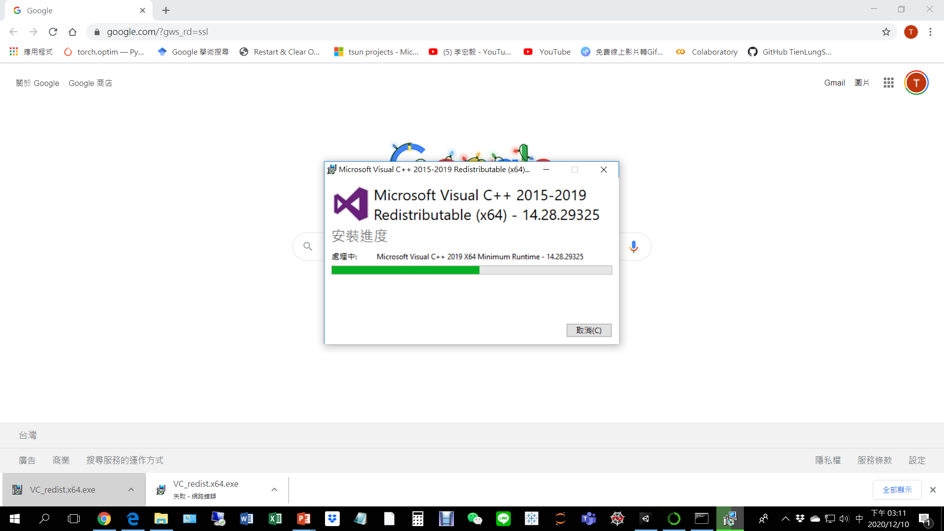
You might need to download MS VC redistributable

Slide 29
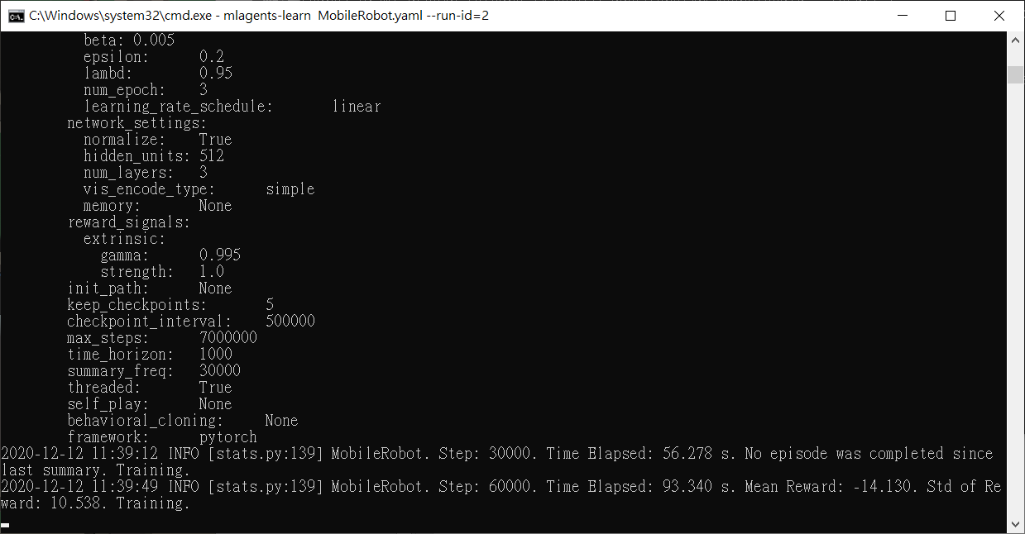
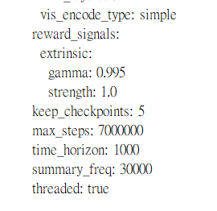
11. Training

